Slide 1
USPSTF Lung Cancer Screening Update
Notes:
Rules for a 30 minute chalk talk:
Scaffold the chunks (minimize intrinsic load)
3-4 minute chunks (plan for 4 or 5?)
Each chunk is meant to answer, as clearly as possible, a key objective phrased as a difficult multiple choice question.
Incorporate interactive features
Align audio and visual content
Eliminate unnecessary content
Try to help highlight patterns / connections for content
Apply content to a generative scenario
Use signaling to highlight key points (minimize extraneous load)
Ideally, want to encourage frequent, low stakes quizzing
Med Ed Trial: Encourage contextual interferences: e.g. study relating to patients.
https://fs.blog/2021/02/gian-carlo-rota/

Slide 2
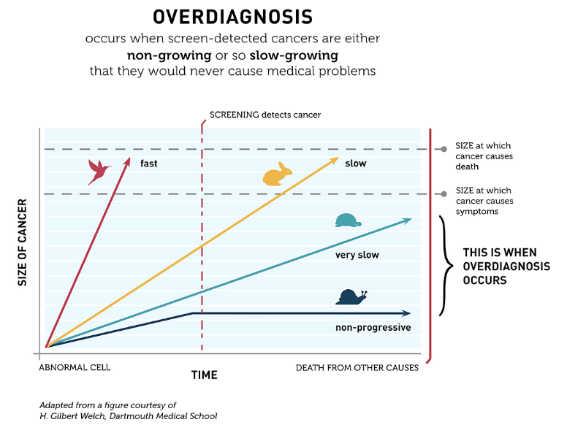

Slide 3
Morning conference on the new US PSTF recommendations and residual unknowns in lung cancer screening
Plenary session Nelson review, JAMA March 2021 addition, conversation with Dr. Buacner podcast
LUNGRADS introduction, rate of surgical resection
“if candidate for surgical resection – no mention of radiation

Slide 4
Lung Ca Screening - via Emily Beck. Large amounts of data online.
Do we have incidence and follow-up data on inceidentalomas and their management?
“14. We suggest that low-dose CT screening programs develop strategies to guide the management of non-nodule findings. (Ungraded Consensus-Based Statement)

Slide 5
What to do with incidentalomas
Remark: Examples include coronary artery calcification, thyroid nodules, adrenal nodules, kidney and liver lesions, thoracic aortic aneurysms, pleural effusions, and parenchymal lung disease.”

Slide 6
Current USPSTF
Mar 2021 USPSTF update -> age now 55->50 to 80; minimum pack years 30->20 and quit within the last 15 years. https://jamanetwork.com/journals/jama/fullarticle/2777244

Slide 7
NLST
N=53,454
3 annual rounds of LDCT
24.2% had abnormal results, 96% of which did not lead to ca diagnosis; 11% required invasive procedure.

Slide 8
NELSON
RCT – LDCT at yr (0,1,3,5.5) vs no screening
Inclusion (current/former wn 10 y smokers; 50-74) – 13,195 men
Primary: lung ca mortality: 156 men (screened) 206 (control) dead at 10y from lung ca. RR 0.76.
Secondary: all cause mortality (RR 1.01 - no difference), lung cancer dx
Diff from NLST: volume-based nodule-management in NELSON vs diameter-based in NLST.

Slide 9
However, a meta-analysis of 7 randomized controlled trials using LDCT also showed no difference in all-cause mortality (RR 0.96; 95%CI 0.92-1.00; p=0.67)(5)
Sadate A, Occean BV, Beregi JP, Hamard A, Addala T, de Forges H, Fabbro-Peray P, Frandon J. Systematic review and meta-analysis on the impact of lung cancer screening by low-dose computed tomography. Eur J Cancer 2020; 134: 107-114.
Notes:
“As opposed to the NLST trial (53,454 participants), the NELSON trial (13,195 participants) showed no difference in all-cause mortality, possibly because of underpowering. However, a meta-analysis of seven randomized controlled trials using LDCT also showedno differencein all-causemortality (RR,0.96;95% CI, 0.92–1.00; P= 0.67) (5). Thus, the effect of LDCT screening on all-cause mortality remains unclear.”
Review of this meta-analysis, the clin-mart RWD, and an additional smoking cessation paper.
https://www.atsjournals.org/doi/pdf/10.1164/rccm.202012-4505RR

Slide 10
Breathe easy July 21 2020 – shared decision making in lung cancer screening.
Prediction model - https://www.atsjournals.org/doi/pdf/10.1164/rccm.202104-1009ED
- notably, they state that ~10% of eligible patients currently get screened. Authors state 50% might be reasonable (not clear what this is based on)
PLCOm2012 is another prediction score
The eligibility criteria are another inherent prediction model

Slide 11
Nishi – retrospective analysis of Clinformatics Data Mart health insurance database - RWD
N=11,520 who underwent LDCT screening in 2016 compared to matched controls who did not undergo screening.
20.7% (vs 6.8% in control) underwent CT w/n 1 yr. 0.3% PET-CT, 0.05% MRI.
0.9% (vs 0.3% in NLST) underwent thorascopy, 1.3% vs 0.6% w CT-guided biopsy, 2.0 vs 1.2% for bronchoscopy.
Thus, the difference in CT between screened vs not (13.8%) was actually less than imaging rate in NLST (21.7%)
Nishi SPE, Zhou J, Okereke I, Kuo YF, Goodwin J. Use of Imaging and Diagnostic Procedures After Low-Dose CT Screening for Lung Cancer. Chest 2020; 157: 427-434.
Notes:
### Sensitivity to imaging follow-up algorithms?
Discussion on the follow-up used in the trials

Slide 12
Absolute benefits and harms
### Editorial of chance of benefits and risk of harm: JAMA. 2020;324(10):937-938. doi:10.1001/jama.2020.0354
Lung cancer specific mortality RRR of 20-33% in high-risk populations
Number needed to screen: Misleading comparison between other screening tests (such as breast cancer, colon cancer) due to differing baseline risk of death from the cancer being screened for. (Ie. NNS is not a surrogate for strength of the test)

Slide 13
https://pubmed.ncbi.nlm.nih.gov/35167780/
The Chain of Adherence for Incidentally-detected Pulmonary Nodules after an Initial Radiologic Imaging Study: A Multi-system Observational Study

Slide 14
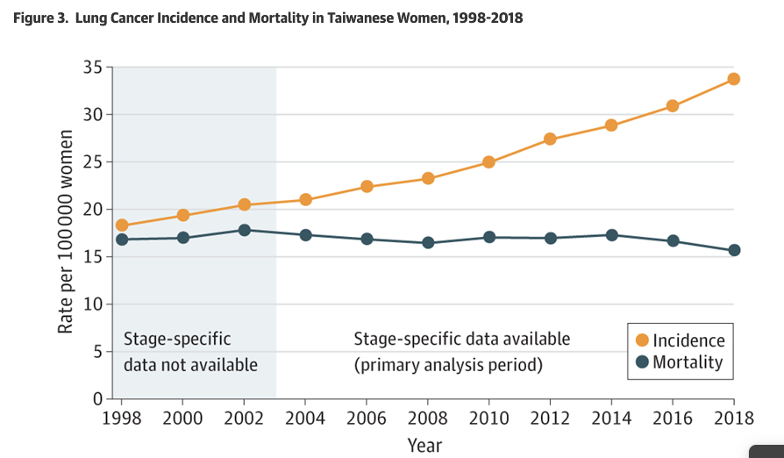
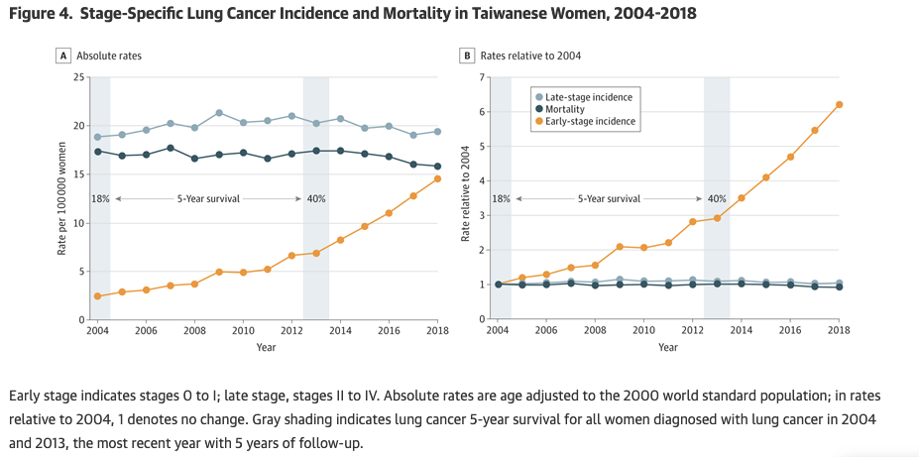
Review: https://www.plenarysessionpodcast.com/episodes/jw9w58yrajfyr6r-7b8sr-6xwsz-6m9zm-y9bgz-wkczr-rkbad-5knrb-cr2ah-mrfaz-r3b96-fnstm-x4xlp
Expansions in screening [52:00]
Association of Computed Tomographic Screening Promotion With Lung Cancer Overdiagnosis Among Asian Women
Notes:
[ ] implications for nodules?

